Slide 1
저널 논문 작성 및 실습
Scientific writing & practice
Ch. 2. Writing about Methodology
Major: Interdisciplinary program of integrated biotechnology
Graduate school of bio- & information technology
Young-il Lim (N110), Lab. FACS
phone: +82 31 670 5200 (secretary), +82 31 670 5207 (direct)
Fax: +82 31 670 5445, mobile phone: +82 10 7665 5207
Email: limyi@hknu.ac.kr, homepage: http://facs.maru.net

Slide 2
Unit 2. Writing about Methodology
2.1 Structure
2.2 Grammar and Writing Skills
2.2.1 Passives and tense pairs
2.2.2 Use of ‘a’ and ‘the’
2.2.3 Adverbs and adverb location
2.3 Writing Task: Build a Model
2.3.1 Building a model
2.3.2 Key
2.3.3 The model
2.3.4 Testing the model
2.4 Vocabulary
2.4.1 Vocabulary task
2.4.2 Vocabulary for the Methodology section
2.5 Writing a Methodology Section
2.5.1 Write a Methodology section
2.5.2 Key

Slide 3
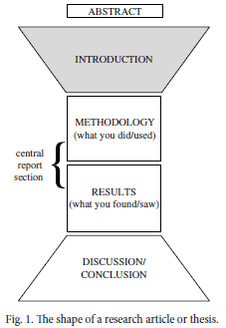
Unit 2. Writing about Methodology
2.1 Structure
Keywords
Research highlights
Graphical abstract
Connectivity:
A living paper is created by connectivity between sentences, paragraphs, parts, Tables, Figures, and Equations.
Interface
between two sections
Symmetrical structure
Document forever:
Your article is an organism being able to live longer than you.
Appendix
Nomenclature
Acknowledgements
References

Slide 4
Unit 5. Writing the methodology
2.1 Structure
- The title of this section varies in different disciplines and in different journals. It is sometimes called Materials and Methods, or it can be called Procedure, Experiments, Experimental, Simulation, Methodology or Model.
- This section is the first part of the central report and it reports what you did and what you used.
- Some requirement of this section you can pick up from a Guide for Authors from your journals.
- it is true that your work must be contain sufficient detail to be repeatable
- This section contains a new procedure, a new method and a new approach.
- you display to the reader that you understand the tasks you have set and have performed them correctly.
- We write this methodology section so that the reader can not only carry out experiment or simulation and obtain similar results, but also understand and accept your procedure.

Slide 5
Unit 2. Writing about Methodology
2.1 Structure
- What do we deal with methodology/ Experiments section?
      How do I start the methodology/Experiments section? What type of sentence should I begin with?
      What type of information should be in this section, and in what order?
      How do I end this section?
    - There is an example for this section with the title: Changes in the chemistry of ground water in the chalk of the London Basin.

Slide 6
1 The current investigation involved sampling and analyzing six
sites to measure changes in groundwater chemistry. 2 The sites
were selected from the London Basin area, which is located in the
south-east of England and has been frequently used to interpret
groundwater evolution.^{2,3,4}
3 A total of 18 samples was collected and then analyzed for the isotopes
mentioned earlier. 4 Samples 1–9 were collected in thoroughly-rinsed
25 ml brown glass bottles which were filled to the top and then sealed
tightly to prevent contamination. 5 The filled bottles were shipped
directly to two separate laboratories at Reading University, where
they were analyzed using standard methods suitably miniaturized to
handle small quantities of water.⁵
6 Samples 10–18 were prepared in our laboratory using a revised
version of the precipitation method established by the ISF Institute in
Germany.⁶ 7 This is method obtains a precipitate through the addition
of BaCl₂.2H₂O; the resulting precipitate can be washed and stored
easily. 8 The samples were subsequently shipped to ISF for analysis by
accelerator mass spectrometry (AMS). 9 All tubing used was stainless
steel, and although two samples were at risk of CFC contamination
as a result of brief contact with plastic, variation among samples was
negligible.

Slide 7
2.2 Grammar and writing skills
- Passives and tense pairs
- Use of ‘a’ and ‘the’
- Adverbs and adverb location
When a sentence changes from active to passive, it looks like this:
  The dog bit the policeman. active
  The policeman was bitten by the dog. passive
But in formal academic writing, when you report what you did, you don’t
write ‘by us’ or ‘by me’ when changing the sentence from active to passive.
You simply leave the agent out, creating an agentless passive:
  We/I collected the samples. active
  The samples were collected. passive
Before you begin to write the description of what you did and used, you need to check with the Guide for Authors in your target journal.
to find out whether this part of the paper or thesis should be written in the passive or in the active.
You can use active if you worked as a part of a research team.
Using the active is not usually appropriate when you write your PhD thesis because you worked alone.
In most cases, you will find that in papers and theses, the procedure you used in your research is described in the passive, either in the Present Simple passive (is collected) or in the Past Simple passive (was collected).

Slide 8
2.2 Grammar and writing skills
- Passives and tense pairs
- Use of ‘a’ and ‘the’
- Adverbs and adverb location
There are two common errors in the way passives are used in this
section. First, look at these two sentences:
(a) A flexible section is inserted in the pipe. Present Simple passive
(b) A flexible section was inserted in the pipe. Past Simple passive
When you write about what you did and what you used, you need to be able to distinguish between standard procedures. In the examples above,
uses the Present Simple tense to describe what is normally done or to describe a standard piece of equipment used in the research
uses the Past Simple tense to describe what you did yourself. It is conventional in this section to use the passive for
the agent of the action is not mentioned in the sentence — we don’t add ‘by the researcher’ or ‘by me’ at the end.

Slide 9
2.2 Grammar and writing skills
- Passives and tense pairs
- Use of ‘a’ and ‘the’
- Adverbs and adverb location
This is a very common error, If the reader cannot identify your contribution, that is a disaster! Look at these two examples:
Two dye jets are placed in the laser cavity. A gain jet is then excited
by an argon ion laser and the pulses are spatially filtered in order to
obtain a Gaussian beam. Polarisation is confirmed using a polarizing
cube. The pulses were split into reference pulses and probe pulses and
the reference pulses were carefully aligned into the detector to minimize
noise levels.
In this case, splitting the pulses into two groups for testing was the significant
innovation of the writer’s research team but the only way the reader knows
this is because of the change in tense from Present Simple passive to Past
Simple passive (were split).
Samples for gas analysis were collected using the method described by
Brown (1999), which uses a pneumatic air sampling pump.
You use the Past Simple agentless passive to describe your procedure (the samples were collected using a suction tube) but you may also need to use exactly the same Past Simple agentless passive to describe the procedure used by the other researcher whose you are citing.

Slide 10
2.2 Grammar and writing skills
- Passives and tense pairs
- Use of ‘a’ and ‘the’
- Adverbs and adverb location
One way to make sure that your own contribution is clear and easy
to identify is by marking it with words — perhaps by adding phrases
like In this study, the samples were collected using a suction tube or In
our experiments the samples were collected using a suction tube, and by
identifying the procedure used by other researchers with careful references
at the appropriate place in the sentence (In Brown (1999) the samples were
collected using a suction tube).
There are five possible uses that you may need. Note the different tenses.
 | What do you mean? | How can you make it clear?
1 | X was (collected/ substituted/adjusted etc.) by me in the procedure or work that I carried out | Either move to the active (We collected/adjusted/substituted etc.) or add words or phrases such as here/in this work/in our model or use a ‘dummy’ subject such as This experiment/The procedure

Slide 11
2.2 Grammar and writing skills
- Passives and tense pairs
- Use of ‘a’ and ‘the’
- Adverbs and adverb location
 | What do you mean? | How can you make it clear?
2 | X was (collected/ substituted/adjusted etc.) by the person whose procedure or work I am using as a basis for, or comparing with, my own | Give a research reference and/ or add words/phrases such as in their work/in that model
3 | X is (collected/substituted/ adjusted etc.) normally, i.e. as part of a standard procedure | You may need a research reference even if it is a standard procedure, depending on how well-known it is. Use phrases such as as in⁵
4 | X is (collected/substituted/ adjusted etc.) as you can see in Fig. 1, but it was collected/substituted/adjusted etc. by me | Move to the active (We collected/adjusted/substituted etc.) if you can or make sure that you come out of the Present Simple passive when you stop describing the figure

Slide 12
2.2 Grammar and writing skills
- Passives and tense pairs
- Use of ‘a’ and ‘the’
- Adverbs and adverb location
 | What do you mean? | How can you make it clear?
5 | X is (collected/substituted/ adjusted etc.) by me in the procedure/work that I carried out, but my field requires authors to write procedural descriptions in the Present Simple tense. (This is quite common in pure mathematics) | Either move to the active (‘We collect/adjust/substitute etc.) or add words or phrases such as here/in this work/ in our model or use a ‘dummy’ subject such as This experiment/The procedure

Slide 13
2.2 Grammar and writing skills
- Passives and tense pairs
- Use of ‘a’ and ‘the’
- Adverbs and adverb location
This is one of the most problematic areas of English grammar and usage.
Many languages do not have separate words for a and the, and even if they
do, these words may not correspond exactly to the way in which they are
used in English. Students studying English as a second language are often
given the following useful rule, but sometimes confusing:
SINGULAR COUNTABLE NOUNS NEED A DETERMINER
A determiner is a word like the, a, my, this, one, some. It’s a difficult
rule to operate successfully because two problems need to be solved before
you can use it.
Firstly, it’s hard to know exactly which nouns are countable
and,
secondly, even when you know, how do you decide whether to use a
or the?

Slide 14
2.2 Grammar and writing skills
- Passives and tense pairs
- Use of ‘a’ and ‘the’
- Adverbs and adverb location
Let’s look at the first problem. Deciding which nouns are countable
nouns and which aren’t as easy as it looks. Many nouns which aren’t considered uncountable can actually be used ‘countably’. Nouns like death or childhood, for example, can occur in the plural:
  There have been three deaths this year from pneumonia.
  Our childhoods were very different; I grew up in France and she grew
  up in China.
  and so can nouns like industry:
  Many industries rely on fossil fuels.
  Even names of materials like steel can occur in the plural:
  Some steels are used in the manufacture of medical instruments
Note. when you use a noun like industry, stop and think — do you mean industry in general (uncountable) or a particular industry (countable)?

Slide 15
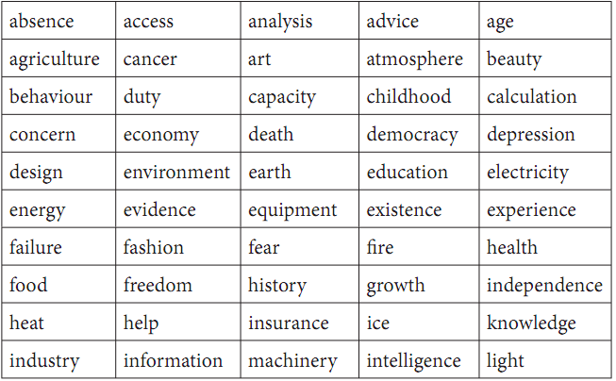
2.2 Grammar and writing skills
- Passives and tense pairs
- Use of ‘a’ and ‘the’
- Adverbs and adverb location
Exercise In the following list of uncountable nouns, mark those which can also be used in the plural

Slide 16
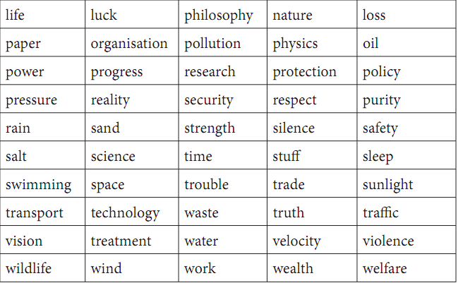
2.2 Grammar and writing skills
- Passives and tense pairs
- Use of ‘a’ and ‘the’
- Adverbs and adverb location
Exercise
Key of this exercise (next slides): The nouns which can also have a countable meaning appear in italics

Slide 17
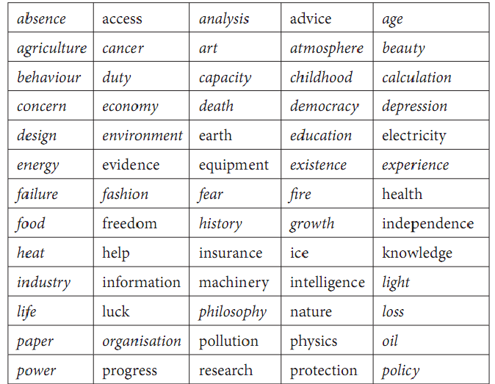
2.2 Grammar and writing skills
- Passives and tense pairs
- Use of ‘a’ and ‘the’
- Adverbs and adverb location

Slide 18
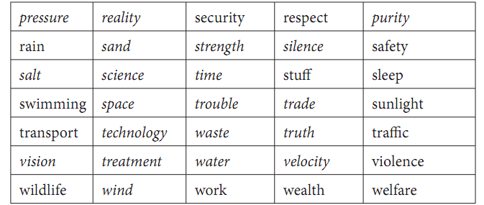
2.2 Grammar and writing skills
- Passives and tense pairs
- Use of ‘a’ and ‘the’
- Adverbs and adverb location
Key of this exercise (next)

Slide 19
2.2 Grammar and writing skills
- Passives and tense pairs
- Use of ‘a’ and ‘the’
- Adverbs and adverb location
Now look at the second problem
How do you decide whether to use a or the? You may have been told that a is used for general reference and the is used for specific reference, but in the following sentence:
  There is a book on the shelf above my desk; can you bring it here?
In fact, that part of the sentence specifies which book the speaker wants. So if the specific/general criterion doesn’t help you to select a or the, what does?
For example, in the sentence below, why does the first reference to the cheese sandwich use a and the second reference use the if both refer to the same specific sandwich?
  I had a cheese sandwich and an apple for lunch. The sandwich was
  fine but the apple had a worm in it.
The difference is that the first time the speaker mentions the cheese sandwich or the apple, only the speaker knows about them — but the second time, both the speaker and listener know. The worm, however, is ‘new’ to the listener, and so is referred to using a. Now we can add a new rule:

Slide 20
2.2 Grammar and writing skills
- Passives and tense pairs
- Use of ‘a’ and ‘the’
- Adverbs and adverb location
Rule 1
USE THE IF OR WHEN YOU AND YOUR READER BOTH
KNOW WHICH THING/PERSON YOU MEAN.
This is true even if the thing or person has not been mentioned before
for example, in the following sentences:
  I arrived at Heathrow Airport but the check-in was closed.
  I bought a new computer but the keyboard was faulty.
  He lit a match but the flame went out.
Rule 2
USE THE IF THERE IS ONLY POSSIBLE REFERENT
We removed the softest layer of membrane.
Cairo is the capital of Egypt.
The opening was located in the centre of each mesh.
Government policy is committed to protecting the environment.
The sun’s altitude is used to determine latitude.

Slide 21
2.2 Grammar and writing skills
- Passives and tense pairs
- Use of ‘a’ and ‘the’
- Adverbs and adverb location
Rule 3
USE A IF IT DOESN’T MATTER or YOU DON’T KNOW
or YOUR READER DOESN’T KNOW WHICH THING/
PERSON YOU ARE REFERRING TO.
A 35 ml brown glass bottle was used to store the liquid. (It doesn’t
matter which 35 ml brown glass bottle was used.)
The subject then spoke to an interviewer. (It doesn’t matter which
interviewer/I know which one but you don’t.)
It works on the same principle as a combustion engine. (It doesn’t
matter which combustion engine.

Slide 22
2.2 Grammar and writing skills
- Passives and tense pairs
- Use of ‘a’ and ‘the’
- Adverbs and adverb location
Sometimes the choice of a or the changes the meaning of the sentence
completely:
(a) This effect may hide a connection between the two. (There may possibly
be a connection between the two but if there is, we cannot see it.)
(b) This effect may hide the connection between the two. (There is
definitely a connection between the two but we may not be able to see
it because of this effect.)
Here’s another pair in which the choice of a or the has a significant
effect on the meaning (∅ is used here to indicate the plural of a):
(a) The nodes should be attached to ∅ two adjacent receptor sites. (There
are many receptor sites and any two adjacent ones will do.)
(b) The nodes should be attached to the two adjacent receptor sites. (There
are only two receptor sites.)

Slide 23
2.2 Grammar and writing skills
- Passives and tense pairs
- Use of ‘a’ and ‘the’
- Adverbs and adverb location
An obvious grammatical error is not as bad as an error which is invisible A proofreader or editor will notice an obvious grammatical error and correct it.
These hidden errors are worrying because neither the writer nor the editor/proofreader knows they have occurred and yet the sentence does not mean what the writer intended.
Error can be corrected
Error can't be corrected
Note. Common hidden errors include mistakes in the use of a and the (see
Section 2.2.2 above), whether or not to use a comma before the word which
in relative clauses and adverb location errors. Adverb location errors are
easy to make and hard to detect.

Slide 24
2.2 Grammar and writing skills
- Passives and tense pairs
- Use of ‘a’ and ‘the’
- Adverbs and adverb location
In the first place, adverbs needing prepositions can be ambiguous (Look at that dog with one eye can either mean USING one eye or HAVING one eye)
The second place, adverbs may attach themselves to unexpected parts of a sentence. Be careful where you put your adverb, and be especially careful if you are using more than one adverb in a sentence. Here is an example:
The patient was discharged from hospital after being shot in the back with a 9 mm gun.
He gave a lecture about liver cancer at the hospital last January.
Did the doctors shoot her?
Was the lecture in the hospital — or the cancer? Did the lecture
refer to cancer cases occurring in January or did the lecture itself occur in
January?

Slide 25
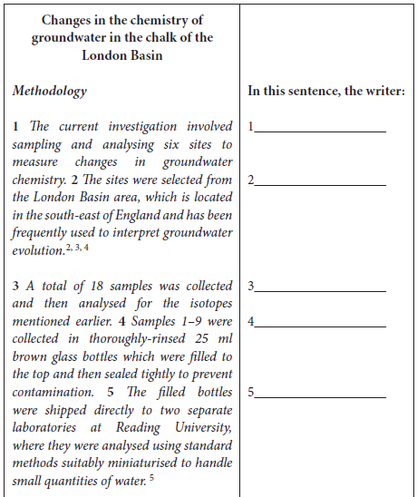
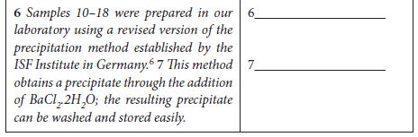
Unit 2. Writing about Methodology
2.3 Writing Task: Build a Model
2.3.1 Building a model
2.3.2 Key
2.3.3 The model
2.3.4 Testing the model
Short description
(modeling of Methodology)

Slide 26
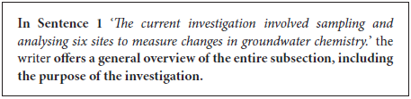
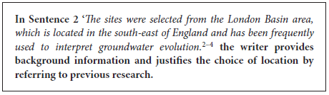
2.3 Writing Task: Build a Model
2.3.1 Building a model
2.3.2 Key
2.3.3 The model
2.3.4 Testing the model
Introduce the Methodology
Passive voice
Why do I need to justify or give reason for what I did?

Slide 27

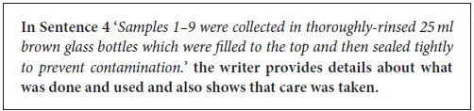
2.3 Writing Task: Build a Model
2.3.1 Building a model
2.3.2 Key
2.3.3 The model
2.3.4 Testing the model
Top-down
Passive voice
Most of the test or In all cases
Your experiment or simulations may seem obvious to you, but may not be obvious to every reader
Make sure use correct symbol.

Slide 28
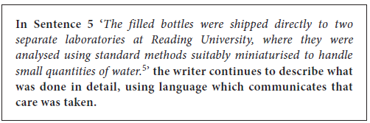
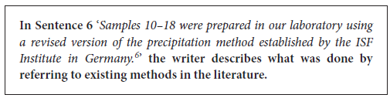
2.3 Writing Task: Build a Model
2.3.1 Building a model
2.3.2 Key
2.3.3 The model
2.3.4 Testing the model
Continue describe Method in detail
Some time you use the methods were discovered by someone else.
Present simple for is identical to the reference
Past simple for what you did

Slide 29
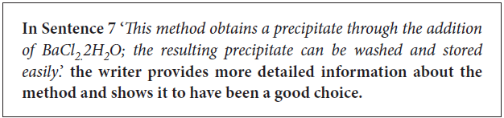
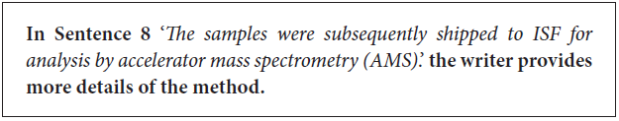
2.3 Writing Task: Build a Model
2.3.1 Building a model
2.3.2 Key
2.3.3 The model
2.3.4 Testing the model
It is essential that your reader accepts the decisions you made about your methodology
Give detail and nothing more

Slide 30
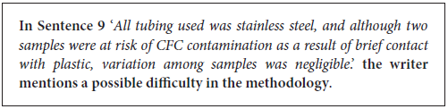
2.3 Writing Task: Build a Model
2.3.1 Building a model
2.3.2 Key
2.3.3 The model
2.3.4 Testing the model
If you do not mention the imperfection in your work, it is very poor impression

Slide 31
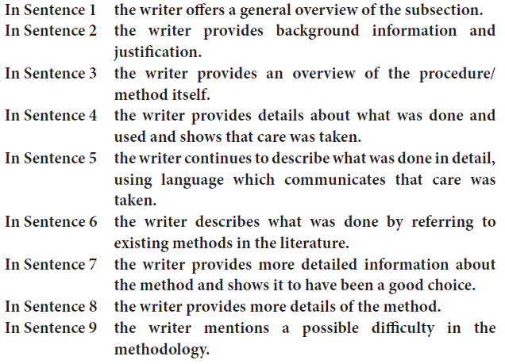
2.3 Writing Task: Build a Model
2.3.1 Building a model
2.3.2 Key
2.3.3 The model
2.3.4 Testing the model

Slide 32
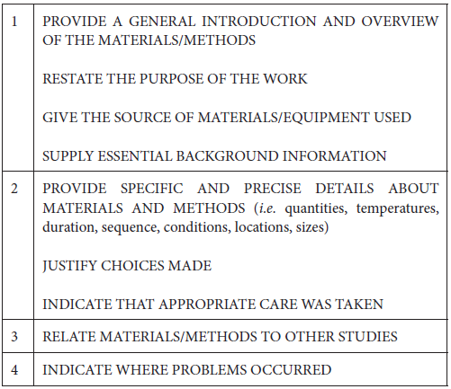
2.3 Writing Task: Build a Model
2.3.1 Building a model
2.3.2 Key
2.3.3 The model
2.3.4 Testing the model
-Help the reader to get a general idea of this section
-Give more detail about method
-Reference the someone’s method
-Imperfections of Method

Slide 33
2.3 Writing Task: Build a Model
2.3.1 Building a model
2.3.2 Key
2.3.3 The model
2.3.4 Testing the model
Homework 2-1
Find a paper related to your research subject and print out it. Read the Methodology part of this paper and mark the model component (1, 2, 3, 4, or 5). Make a flow chart of this Methodology with a key concept. Please state this Methodology in terms of weak points, strong points, suggestions for improvement and grammatical errors.
Please distribute us your homework and present in the class your homework, using the paper material (without beam project).
Each student has 10 minutes for presentation.

Slide 34
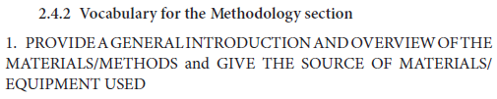
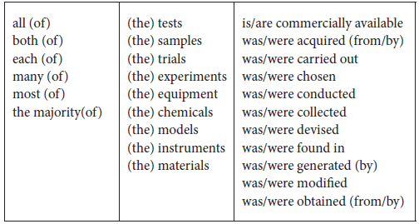
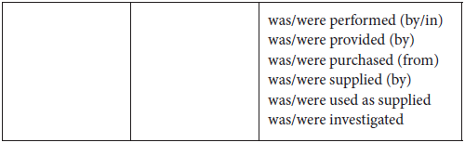
2.4 Vocabulary

Slide 35
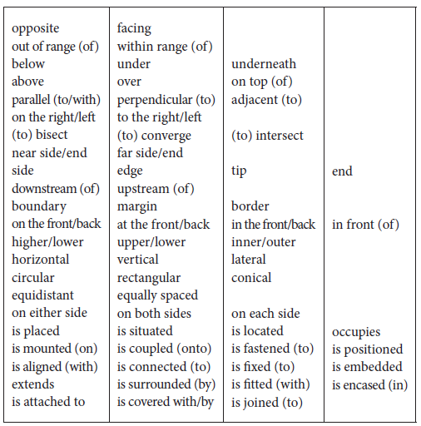
2.4 Vocabulary

Slide 36
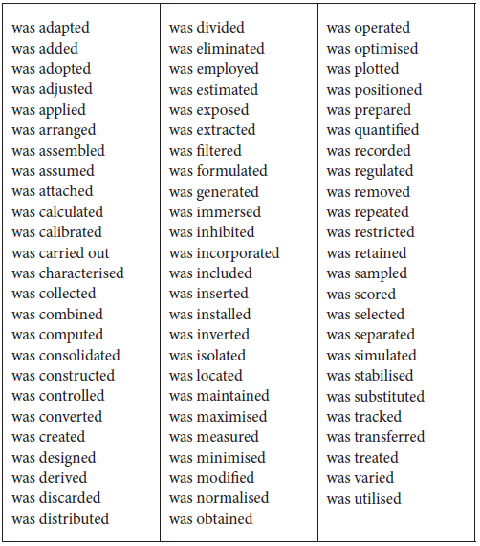
2.4 Vocabulary
-First column are general verbs
-Second column contains technical verbs
-Third column contains less technical verbs

Slide 37
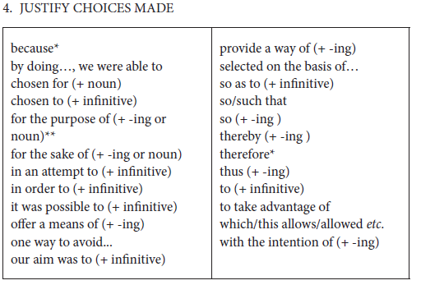
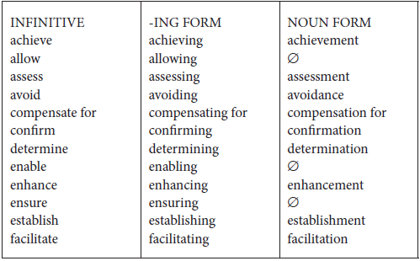
2.4 Vocabulary

Slide 38
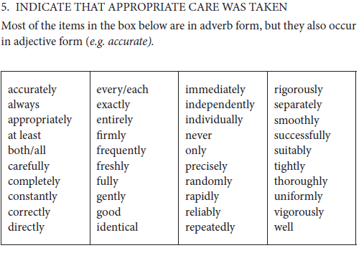
2.4 Vocabulary

Slide 39
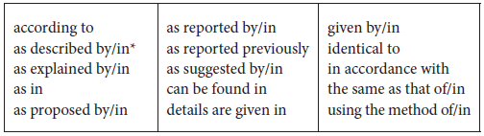
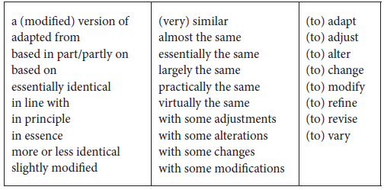
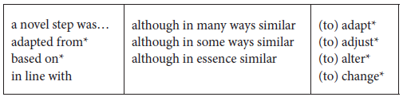
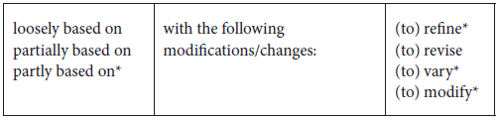
2.4 Vocabulary
Exactly the same as the one you cite
Similar to the one you cite
Significantly different from the one you cite

Slide 40
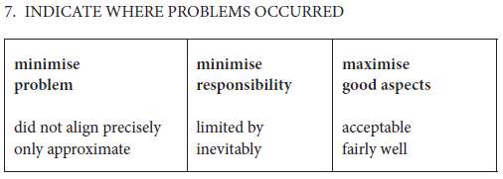
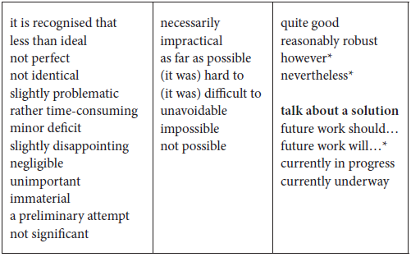
2.4 Vocabulary

Slide 41
2.5 Writing a methodology section
- write a methodology section
Homework 2-2
Write a methodology on your research topic (for potential publication). Respect the model presented in this lecture and use the vocabularies and expressions learned so far. For citing, use EndNote.
Please submit to the teacher by email or by hard-copy.
Each student individually has 10 minutes for correction with the teacher.

